Slide 1
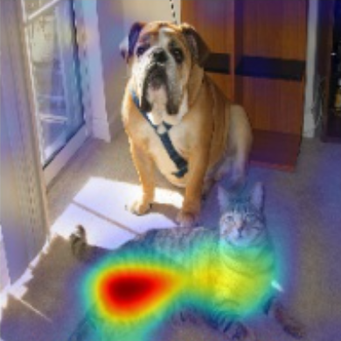
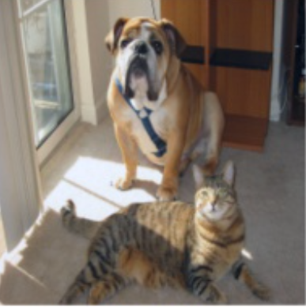
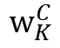
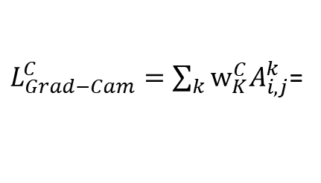
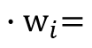
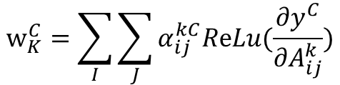
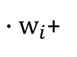
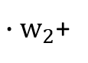
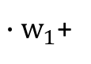
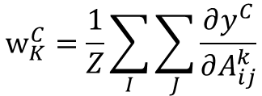
CNN Visual Explanations
Class Activation Map (类激活映射,Grad-CAM)
${∙w}_{1}$+
${∙w}_{2}$+
${∙w}_{i}$+
$${∙w}_{i}=$$
Cam
$$w_{K}^{C}$$
Cat
Dog
$L_{Grad−Cam}^{C}=\sum_{k}{w_{K}^{C}A_{i,j}^{k}}$=
Pool
FC layers
Label
Convolutional layers
Back prop till last convolution layer
$$w_{K}^{C}=\sum_{I}{\sum_{J}{α_{ij}^{kC}ReLu(\frac{∂y^{C}}{∂A_{ij}^{k}})}}$$
Grad-CAM
Ramprasaath R. Selvaraju, Michael Cogswell et.al.
Grad-CAM: Visual Explanations from
Deep Networks via Gradient-based Localization. arXiv:1610.02391, 2019
Aditya Chattopadhyay, Anirban Sarkar, Prantik Howlader,et. al.
Grad-CAM++: Generalized Gradient-based Visual
Explanations for Deep Convolutional Networks. arXiv:1506.06579, 2017
$$w_{K}^{C}=\frac{1}{Z}\sum_{I}{\sum_{J}{\frac{∂y^{C}}{∂A_{ij}^{k}}}}$$
Grad-CAM++

Slide 2
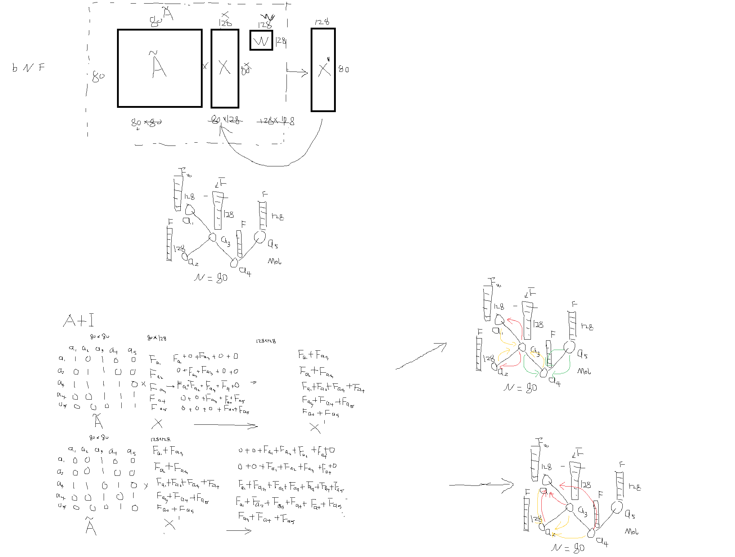

Slide 3
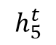
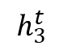
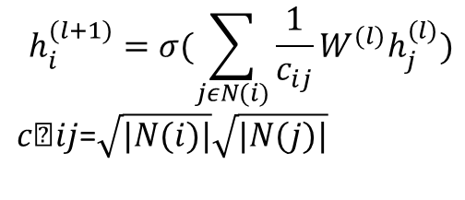
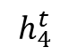
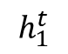
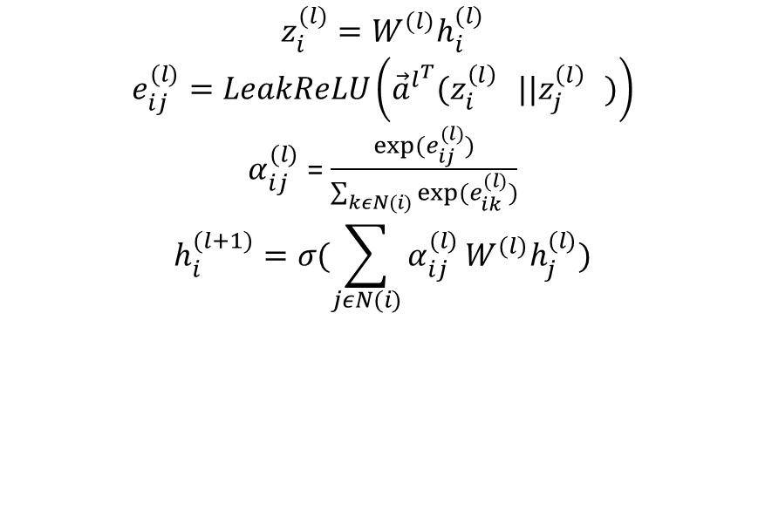
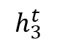
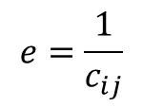
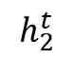
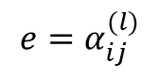
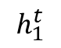
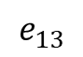
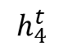
MPNN Theory
GCN/ GAT
$$h_{1}^{t}$$
$$h_{i}^{(l+1)}=σ(\sum_{jεN(i)}{\frac{1}{c_{ij}}}W^{(l)}h_{j}^{(l)})$$
$c﷮ij$=$\sqrt{|N(i)|}\sqrt{|N(j)|}$
$$e=\frac{1}{c_{ij}}$$
$$h_{3}^{t}$$
GCN
1
$$e_{13}$$
$$h_{1}^{t}$$
$$h_{5}^{t}$$
3
$$h_{3}^{t}$$
5
2
4
$$z_{i}^{(l)}=W^{(l)}h_{i}^{(l)}$$
$$e_{ij}^{(l)}=LeakReLU\left({\vec{a}}^{l^{T}}(z_{i}^{{\left(l\right)}^{}}||z_{j}^{{\left(l\right)}^{}})\right)$$
$α_{ij}^{(l)}$ = $\frac{exp⁡(e_{ij}^{(l)})}{\sum_{kεN(i)}{exp⁡(e_{ik}^{(l)})}}$
$$h_{i}^{(l+1)}=σ(\sum_{jεN(i)}{α_{ij}^{(l)}}W^{(l)}h_{j}^{(l)})$$
$$h_{4}^{t}$$
GAT
$${e=α}_{ij}^{(l)}$$
$$h_{2}^{t}$$
$$h_{4}^{t}$$
Petar Velickovi,Guillem Cucurull, Arantxa Casanova. Graph Attention Networks. arXiv:1311.2901, 2018
Franco ScarselliAh Chung TsoiMarco Gori et. al. Graphical-Based Learning Environments for Pattern Recognition. arXiv:1506.06579, 2015
2

Slide 4
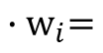
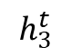
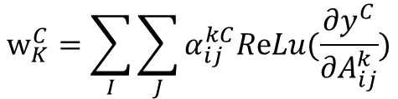
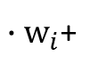
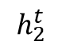
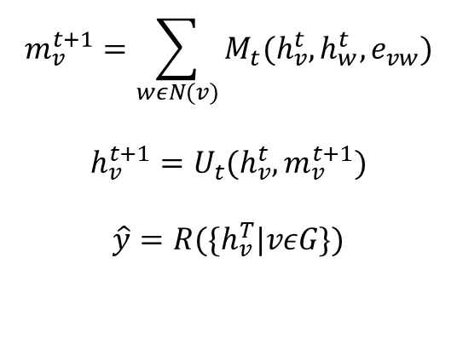
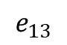
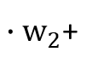
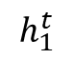
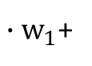
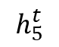
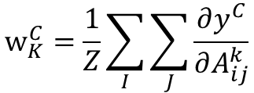
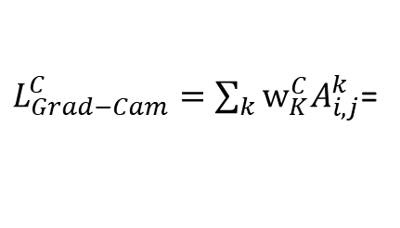
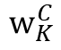
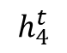
MPNN Visual Explanations
Class Activation Map
${∙w}_{1}$+
${∙w}_{2}$+
${∙w}_{i}$+
$${∙w}_{i}=$$
Cam
$$w_{K}^{C}$$
Inactive
1
$$e_{13}$$
Active
$$h_{1}^{t}$$
$$h_{5}^{t}$$
$L_{Grad−Cam}^{C}=\sum_{k}{w_{K}^{C}A_{i,j}^{k}}$=
3
$$h_{3}^{t}$$
5
FC layers
Label
2
4
Pool
$$m_{v}^{t+1}=\sum_{wεN(v)}{M_{t}(h_{v}^{t},h_{w}^{t},e_{vw})}$$
$$h_{v}^{t+1}=U_{t}(h_{v}^{t},m_{v}^{t+1})$$
$$\hat{y}=R(\{h_{v}^{T}|vεG\})$$
Back prop till last convolution layer
$$w_{K}^{C}=\sum_{I}{\sum_{J}{α_{ij}^{kC}ReLu(\frac{∂y^{C}}{∂A_{ij}^{k}})}}$$
$$h_{2}^{t}$$
$$h_{4}^{t}$$
Grad-CAM
$$w_{K}^{C}=\frac{1}{Z}\sum_{I}{\sum_{J}{\frac{∂y^{C}}{∂A_{ij}^{k}}}}$$
Grad-CAM++
Justin Gilmer, Samuel S. Schoenholz et.al.
Neural Message Passing for Quantum Chemistry. arXiv:1704.01212, 2017

Slide 5
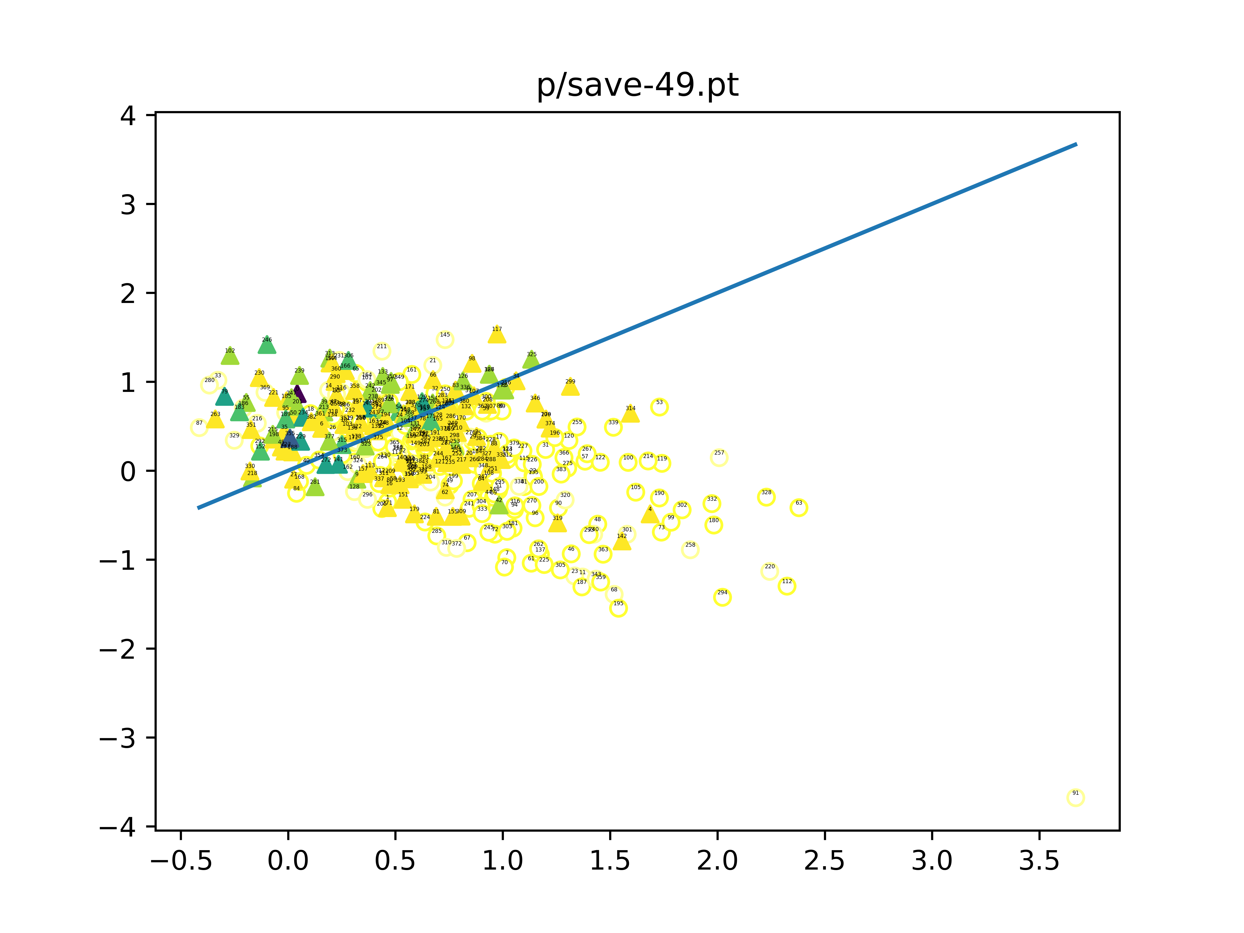
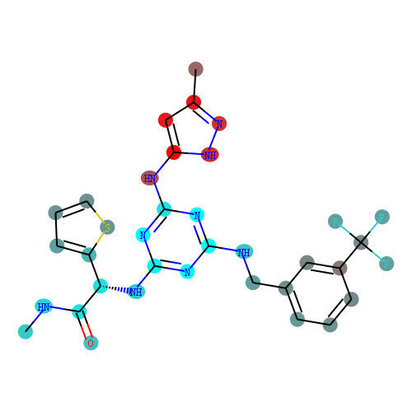
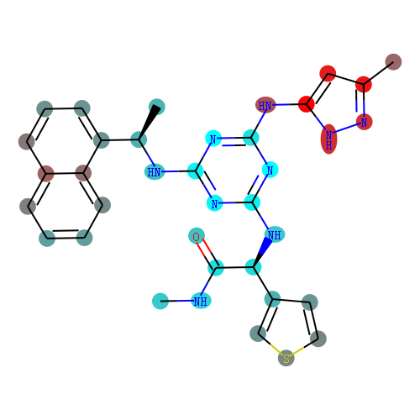
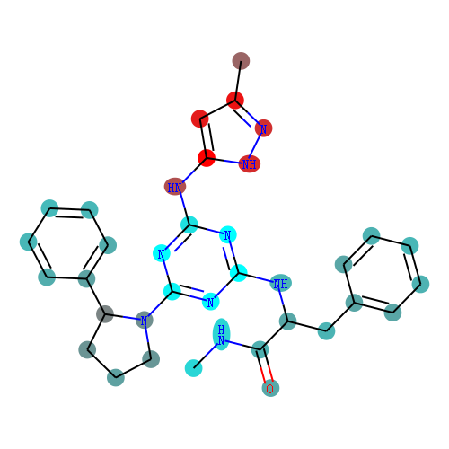
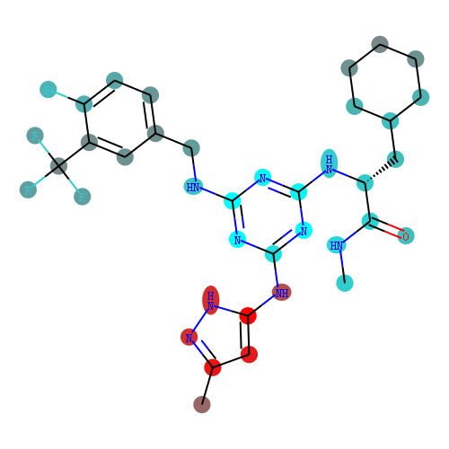
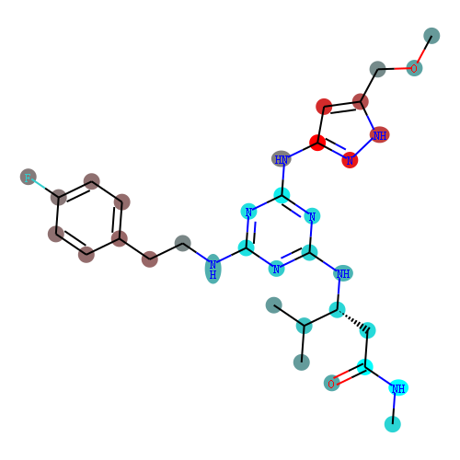
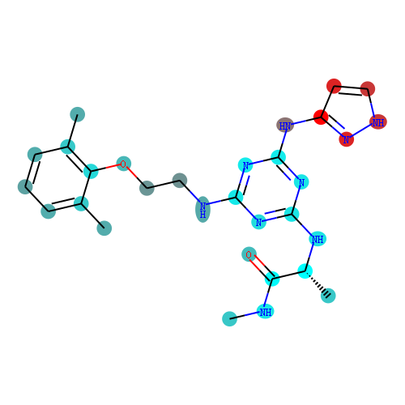
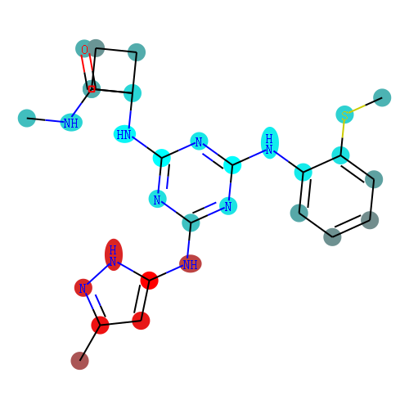
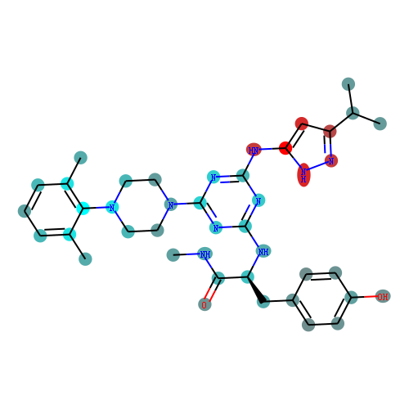
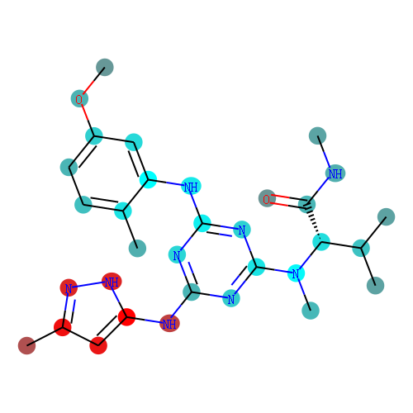
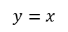


$$y=−x+b$$
$$y=x$$
$$y=x+b$$

Slide 6













$$y=−x+b$$
$$y=x$$
$$y=x+b$$

Slide 7



Slide 8



Slide 9



Slide 10


Slide 11




Slide 12



Pooling
Activation
Dropout
Fully-connected
Encode
Convolution
Input
Matrix
Filter
Feature map
Output

Slide 13


